Slide 1
PERI INSTITUTE OF TECHNOLOGY
Second Review
BE-ECE
Date:03.03.2020

Slide 2
3rd Eye For Blind
Presented By
A. Riyaz Ahamed - 411516106054
M.Santhosh - 411516106056
K.Vairamuthu - 411516106063
N.Vignesh - 411516106064
Supervisor
Guide Name : Mrs. Abisha J.Benelyn, M.E,AP/HOD-ECE

Slide 3
ABSTRACT
Third eye for people who are blind is an innovation which helps the blind people to navigate with speed and confidence by detecting the nearby obstacles using the help of ultrasonic waves and notify them with buzzer sound or vibration. They only need to wear this device as a band or cloth.
According to WHO 39 million peoples are estimated as blind worldwide .They are suffering a lot of hardship in their daily life.
Now a days there are so many instruments and smart devices for visually impaired peoples for navigation but most of them have certain problems for carrying and the major drawbacks is those need a lot of training to use.

Slide 4
Base Paper
M. Narendran, Sarmisthapadhi, Aashita Tiwari ,National Journal of Multidisciplinary Research and Development Impact Factor. “Third eye for the blind using Arduino and ultrasonic sensors” www.nationaljournals.com. ISSN: 2455-9040, RJIF 5.22 ,Volume 3; Issue 1; January 2018; Page No. 752-756

Slide 5
Literature Survey
S.NO | Author | Title | Year | Proposed Idea
1. | Samartha Koharwal, Samer Bani Awwad, Aparna Vyakaranam | Navigation System for Blind - Third Eye | 2019 | In order to support blind and visually impaired people’s mobility indoor and outdoor, this work proposes a simple electronic guidance embedded vision system which is configurable and efficient.
2. | M.Narendran, SarmisthaPadhi, Aashita Tiwari | Third eye for the blind using arduino and ultrasonic sensors | 2018 | This project proposed the design and architecture of a new concept of Arduino based Virtual Eye for the blind people
3. | Mohammed H.Rana and Sayemil | Smart Walking Stick | 2017 | It is based on ping sensor for detecting obstacle, wet electrode, vibration and buzzer
4. | Mohan M.S.Madulika | Electronic Travelling aid For blind navigation | 2016 | It is based on arm7 controller that used ultrasonic technology for detecting the obstacle
5. | Pooja Sharma, Mrs. Shimi S. L | Design and Development of Virtual Eye for the Blind | 2015 | In order to overcome the difficulties in the existing method and to provide the cost effective and user friendly system for blind navigation

Slide 6
Existing System
The existing system consists of the devices or the supports like white cane for helping them to detect the obstacles and travel to places, pet dogs, smart devices like vision a torch for blinds.
But, there were many limitations and problems in this existing systems like in the white cane, it may easily break or crack.
The white cane may get stuck at the pavement cracks of the different objects. Whereas the pet dogs cost is huge and need a lot of training.

Slide 7
Proposed System
The design is based on a special wearable device based on the Arduino board which can be wore like a cloth for blinds. This device is equipped with five ultrasonic sensors, consisting five modules which are connected to the different parts of the body. Among them, two for both the shoulders, another two for both the knees, and one for the glass.
With the use of these five ultrasonic sensors , the blind can detect the objects in a five dimensional view around them and can easily travel anywhere by detecting the obstacles. When the ultrasonic sensor detects obstacle the device will notify the user through vibrations and sound beeps.
This device will help the blind to navigate without holding a stick which is a bit annoying for them.

Slide 8
Block Diagram
Vibration Motor
ARDUINO BOARD
US1
GSM
Left
Buzzer
P1
P2
P3
Tx
US
Rx
US2
Eye
(Centre)
Ultrasonic
sensor
GPS
Mess and Live Location
US3
PIR
Right
Power Supply

Slide 9
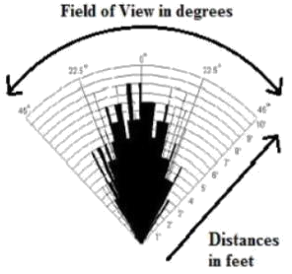
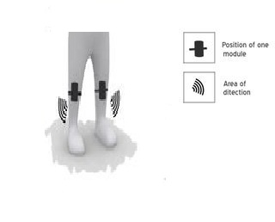
Block Diagram
US1
ARDUINO BOARD
LEFT
LEG
US1
ARDUINO BOARD
RIGHT
LEG
Power Supply
Power Supply
Vibration Motor
Buzzer
Fig 5:
Angle of field of detection

Slide 10
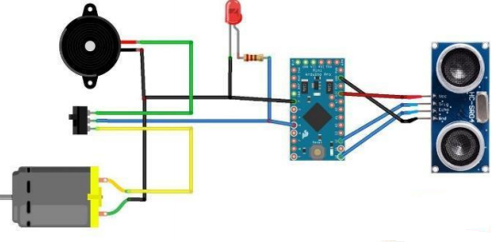
BASIC CIRCUIT DIAGRAM

Slide 11
PROJECT FLOW
Zeroth Review:-
Understanding and Analysation of Project
First Review:-
Literature survey
Basic Working of Components and Their Behaviour
Project design
Second Review:-
Basic Implementation of Project
Basic Work Model

Slide 12
PROJECT FLOW
Third Review:-
Report Work
Work Model
Final Review:-
Report Submission
Complete Work Model

Slide 13
REQUIREMENTS
HARDWARE
1. 3x Arduino Board
2. 5x Ultrasonic Sensors
3. 1x PIR Sensor
4. 1xGPS
5. 1xGSM
6. 5x Buzzer
7. 5x Vibration Motor
8. LEDs
9. Wires
10. Some Required components
SOFTWARE
1. Arduino Software

Slide 14
Reference Paper
Pooja Sharma, Mrs.Shimi S.L and Dr. S Chatterji, International Journal of Scientific Research Engineering & Technology (IJSRET), “ DESIGN OF MICROCONTROLLER BASED VIRTUAL EYE FOR THE BLIND ” , Volume 3, Issue 8 November 2014, ISSN 2278 – 0882 .
Dr. S.Deepa, T.S.Maheshwari, G.JancyRani, A. Jayasri,International Journal of Advanced Research in Science, Engineering and Technology “Third Eye Navigator for Visually Challenged”. Vol. 5, Issue 4 , April 2018.
Samartha Koharwal, Samer Bani Awwad, Aparna Vyakaranam, International Journal of Innovative Technology and Exploring Engineering (IJITEE). “Navigation System for Blind - Third Eye” Volume-8, Issue-5 March 2019, ISSN: 2278-3075.

Slide 15
References
https://www.instructables.com/id/Arduino-Based-Simple-Blind-Navigation-Bracelet-AID/
https://www.ijireeice.com/upload/2015/march-15/IJIREEICE6.pdf
https://store.arduino.cc/usa/arduino-uno-rev3
https://www.robotechmaker.com/2016/11/third-eye-for-blind.html
https://create.arduino.cc/projecthub/muhammedazhar/third-eye-for-the-blind-8c246d

Slide 16
Thank You

